Slide 1
Session Plan: Our Houses in the Future

Slide 2
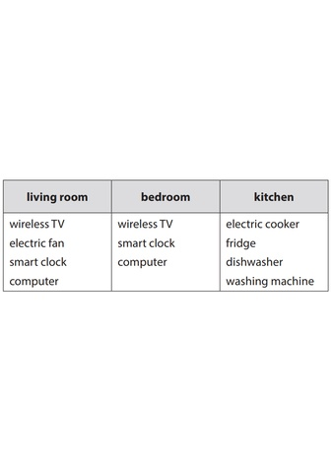
Introduction to the Session Plan
Overview of the session plan aimed at teaching about future houses and appliances.
This session covers vocabulary, grammar, and the practical implications of future housing.
Engages students through various activities and assignments related to the topic.

Slide 3
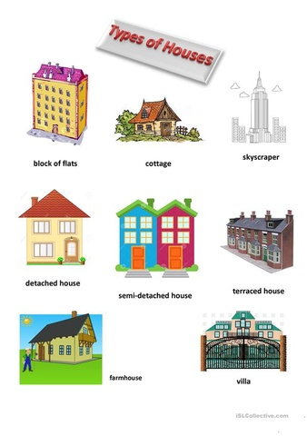
Session Objectives
Students will understand key vocabulary related to future houses.
Grammatical structures like Future Simple and MIGHT for future possibility will be covered.
Enhances competencies through collaborative exercises and independent projects.

Slide 4
Key Vocabulary: Future Houses
Understand and correctly pronounce words like UFO, solar TV, smart TV, etc.
Relate vocabulary to real-world applications and scenarios.
Vocabulary is integral for discussing future innovation in homes.

Slide 5
Grammar Focus: Future Simple and MIGHT
Detailed explanation of Future Simple tense for expressing inevitable actions.
Exploring MIGHT for possibilities and uncertainties regarding future housing.
Includes examples and exercises to reinforce understanding.

Slide 6
Competency Development
Encourages group work, independent projects, and pair working skills.
Strengthens linguistic competence through engaged learning.
Integrates cooperative learning with communicative competence development.

Slide 7
Importance of Houses and Appliances
Discusses the significance of modern houses and their appliances in everyday life.
Students learn how these devices contribute to convenience and sustainability.
Explores the dream of future houses and the potential they hold.

Slide 8
Session Materials Needed
Teacher prepares text books, laptops, loudspeakers, and projectors.
Students bring textbooks and study materials to class.
Materials facilitate an effective teaching and learning process.

Slide 9
Week 27: Session Schedule Overview
Session 1: Getting Started with the lesson - Introduces the topic.
Session 2: A Closer Look 1 - Deepens understanding through focused activities.
Clear timelines and dates for each session provided to facilitate planning.

Slide 10
Teacher and Student Activities Overview
Teacher guides discussions, summarizes opinions, and gives feedback.
Students engage in discussions, take notes, and complete assignments.
Activities are designed to reinforce learning through practice and feedback.

Slide 11
Home Assignments Details
Students read specific conversations again to reinforce comprehension.
Research task: Students go online to explore futuristic houses.
Assignments designed to encourage self-directed learning and exploration.

Slide 12
Feedback Mechanisms
Feedback collected through class discussions and teacher evaluations.
Feedback focuses on individual improvement and class participation.
Constructive feedback aims to enhance student's learning curve.

Slide 13
Quiz: Test Your Knowledge
Which grammar structure expresses future possibility?
A. Past Simple
B. Future Continuous
C. Future Simple
D. MIGHT
Testing knowledge enhances engagement

Slide 14
Quiz: Answer Explained
Understanding possibilities enriches future planning in language.

Slide 15
Key Concepts Illustrated

Slide 16
Sequential Steps for Classroom Activities
Initiate with an engaging introduction on futuristic houses.
Conduct a vocabulary exercise focusing on new terms.
Implement group activities to discuss lesson topics.

Slide 17
Pros and Cons of Modern Housing
Pros
Cons
Enhanced convenience and comfort.
Sustainable and eco-friendly solutions.
Increased connectivity through smart devices.
High initial costs and maintenance.
Privacy concerns with smart technology.
Dependency on technology can lead to issues.

Slide 18
Session Review and Reflection
Review key points discussed during the session.
Encourage students to reflect on their learnings.
Open floor for feedback and future improvement suggestions.

Slide 19
Concluding Thoughts and Takeaways
Students should now appreciate the importance of house appliances.
Encouraged to keep exploring futuristic home concepts.
Call to action: Apply concepts learned in real-life scenarios.

Slide 20
Thank you!

